Slide 1
Health System
Collection Optimization Utilization Review
Period: xxxx – xxxx
Delivered: xxxx

Slide 2
CONSULTANTS:
This presentation is a template. It is up to the consultant to determine which slides are applicable. If some parts of the solution are not used / applicable, they should be removed. Additionally, slides can be revised to meet message / client needs.

Slide 3




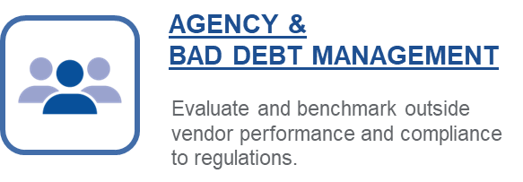




Collection Optimization Manager

Slide 4
Patient Financial Clearance
Unlimited Transactions
Estimated Income/FPL
Propensity to Pay
Address & Identity Verification
Direct Integration into Epic / Real Time
  How Patient Financial Clearance is Used by <<<Insert>>>:
  All patients are run at the point of registration or pre-financial clearance. Transactions are initiated via an interface integration between Epic/Experian. Results are returned to the end user within Epic via the Verify Guarantor screen.
    Address & Identity Verification:
      Validation of address and patient identity.
        Results highlight discrepancies and option to accept/deny provided results.
      Integration within Epic allowing end users to update seamlessly.
    Financial Screening & Payment Plan Advisor:
      Provides Estimated Income, Estimated Household Size, Estimated Federal Poverty Level (FPL) and Propensity to Pay estimates on all patients at the time / before time of service.
      Data is leveraged by front end registration & financial counselors to drive point of service collections and/or financial assistance screening.

Slide 5
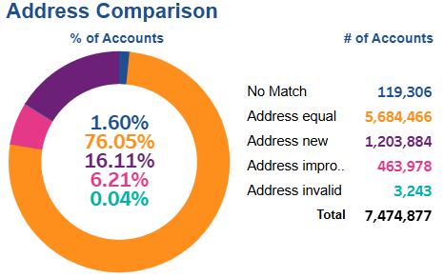
Patient Financial Clearance: Address Verification
Address Verification: <<Insert Period>>>
<<Insert>>> total address searches
  <<<Insert>>> average monthly transaction
Results:
  New Addresses Results: <<Insert %>>
  Improved Address Results: <<Insert %>>
  Total New & Improved: <<Insert %>>
Value:
Unlimited transactions
Return Mail Statement Cost Avoidance: <<Insert>>
Return Mail Manual Work Cost Avoidance: <<Insert hours, FTE and wage impact>>
Impacted AR (collection ability):
  <<Insert>> in initial patient responsibility.
Observations:
Insert observations for this Increased monthly volume since last period (458k vs 498k).

Slide 6
Patient Financial Clearance: Address Verification
Period over Period Trending
Insert Observations and/or proposals

Slide 7

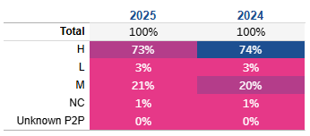
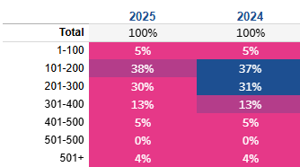
Patient Financial Clearance: Financial Insights
Patient Financial Clearance: <<Insert Period>>>
<<Insert>>> total financial clearance searches
  <<<Insert>>> average monthly transaction
Results:
  Propensity to Pay:
    High: <<Insert %>>
    Medium: <<Insert %>>
    Low: <<Insert %>>
    No Credit or Unknown: <<Insert %>>
  FPL:
    1-100%: <<Insert %>>
    101-200%: <<Insert %>>
    201-300%: <<Insert %>>
    301-400%: <<Insert %>>
    401-500%: <<Insert %>>
    501%+ <<Insert %>>
Value:
Patient financial insights at or before service.
Aide in Point of Service Collection
Aide in identifying Financial Assistance or Program Assistance opportunities
Transaction Volume
Propensity to Pay Distribution
FPL Distribution

Slide 8
Patient Financial Clearance: Financial Insight Trend
Period over Period Trending
Insert Observations and/or proposals

Slide 9
Bankruptcy Scrub & Routing
Unlimited Transactions
Manual Work Avoidance due to Automation
Compliance / Risk Mitigation
Removes Uncollectable Accounts
  How Bankruptcy Scrubs are used by <<Insert>>:
  Summarize process workflow
Identify Lien Opportunities
Increase Cash

Slide 10
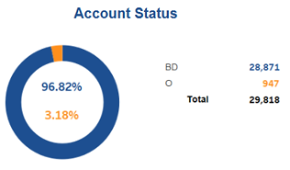
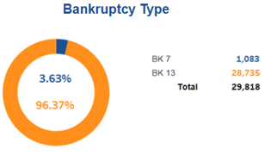
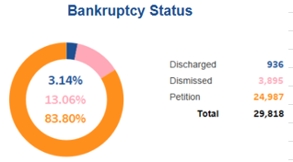
Screening: Bankruptcy Scrub Results
Bankruptcy Scrub: <<Insert Period>>
Total accounts monitored for Bankruptcy: <<Insert>>
Compliance Mitigation & Removal of Uncollectable Accounts
  Total bankruptcies identified: <<Insert Volume @ Insert Dollars>>
  Average monthly: 1,985 @ $617k**
Chapter 7: <<insert %>>
  <<Insert %>> Petitioned
  <<Insert %>> Discharged
  <<Insert %>> Dismissed
Chapter 13: <<Insert %>>
  <<Insert %>> Petitioned
  <<Insert %>> Discharged
  <<Insert %>> Dismissed
Value:
Entire Active AR and Bad Debt accounts are monitored for Bankruptcy activity.
Compliance Mitigation: <<Insert Bankruptcy Result Volume>>
Assume it takes 5 minutes to research, locate and process a paper bankruptcy for all associated accounts:
  <<Insert>> hours or <<insert>> FTEs in automation
  <<Insert>> FTE Cost Savings
Ability to capitalize on additional revenue stream via automated detection (next slide)

Slide 11
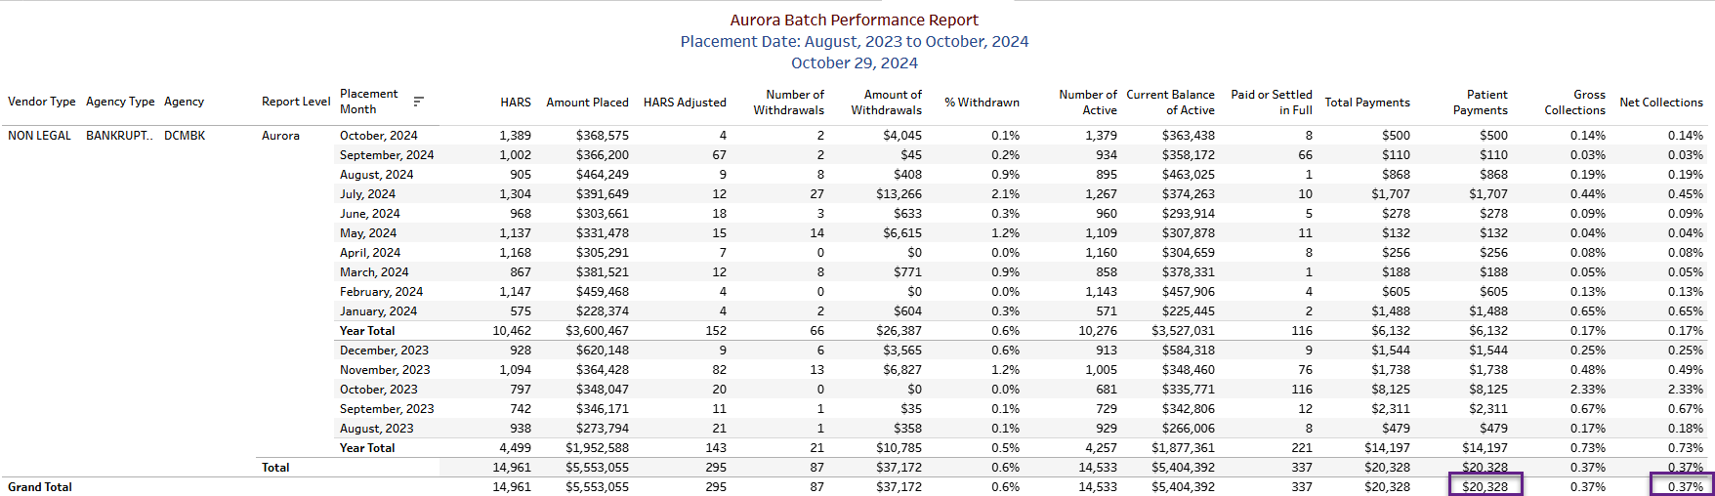
Bankruptcy Scrub --- Optional
Bankruptcy Scrub: <<Insert>>
Value:
Revenue stream by identifying and placing Chapter 13’s to collection vendor.
Agency performance & reconciliation reporting.
Recovery: <<Insert Total Payments minus contingency>> or <<Insert Net Recovery Rate>>
Recovery Since Go Live (Insert Go Live Date): <<Insert Total Payment minus contingency) or <<insert net recovery>>

Slide 12
Bankruptcy Results: Trends
Insert Observations and/or proposals
Notes:
Decrease in chapter 13 filings as compared to last period, increase in chapter 7’s (resulting in adjustment)

Slide 13
Deceased Scrub & Routing
Unlimited Transactions
Manual Work Avoidance due to Automation
Remove Uncollectable Accounts
Identify Probate Opportunities
Increase Cash
  How Deceased Scrubs are used by <<Insert>>:
  Describe process / workflow

Slide 14
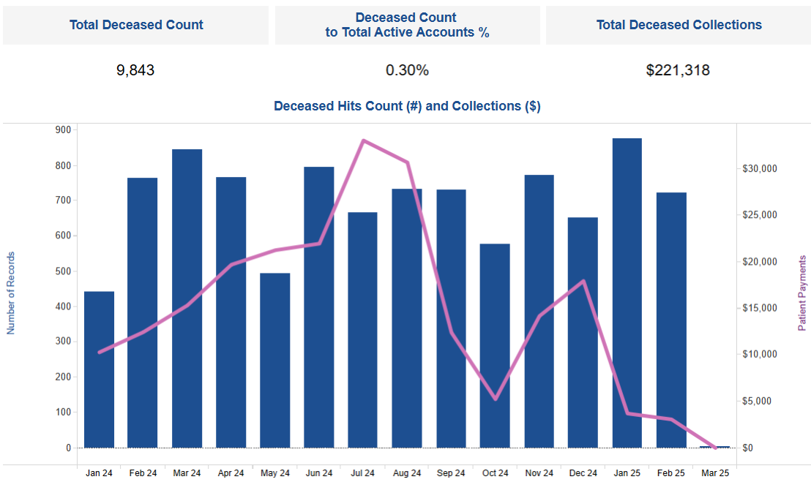
Screening: Deceased Scrub Results
Deceased Scrub: <<Insert Period>>
Total accounts scrubbed for Deceased (recurring): <<Insert>>
Deceased results: <<Insert Volume>>
  Average monthly: <<Insert>>>
Value:
Entire Active AR and Bad Debt Accounts are scrubbed for deceased (select appropriate inventory based on workflow).
Assume it takes 5 minutes to research, process & document a paper/call notification for all associated accounts:
  <<insert>>hours or <<insert>> FTE’s
  <<insert>> FTE Cost savings
Deceased Collections: $<<insert>>

Slide 15
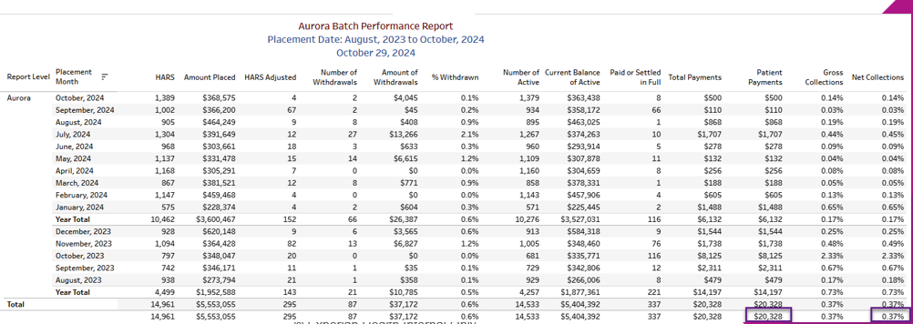
Deceased Scrub --- Optional
Deceased Scrub: <<Insert Period>>
Value:
Revenue stream by identifying deceased accounts and making placement to probate vendor.
Agency performance & reconciliation reporting.
Recovery: <<Insert Total Payments minus contingency>> or <<Insert Net Recovery Rate>>
Recovery Since Go Live (Insert Go Live Date): <<Insert Total Payment minus contingency) or <<insert net recovery>>

Slide 16
Deceased Scrub: Trends
Insert Observations and/or proposals

Slide 17
Return Mail Scrub & Automation
Unlimited Transactions
100% Automated
Manual Work Avoidance
Increase ability to collect
  How the Return Mail workflow is used by <<insert>>:
  Experian leverages the AR file to identify accounts that have been flagged as Return Mail. Those accounts are scrubbed against Experian data sources to locate a new address.
  The guarantor’s name, social security and date of birth (when social security is missing) associated with the New / Improved address results are compared to the name, social security and date of birth of the scrub findings.
  Cases where the address is New/Improved and the name, social and date of birth (when social is missing) are automatically updated in Epic, removing the Guarantor Status, automatically removing the statement hold.
  Cases where the address is New/Improved but the name, social security or date of birth do not match are bypassed, and no update is made in Epic. Scrubbing for a new address continues.

Slide 18
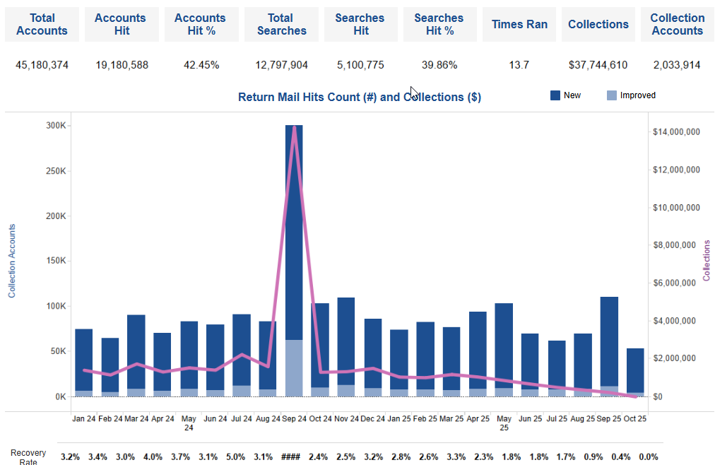
Screening: Return Mail Results
Return Mail Scrub: <<Insert Period>>
Total accounts scrubbed for Return Mail: <<Insert>>
Return Mail results: <<Insert Volume>>
  Average monthly: <<Insert Volume>>>
Value:
Assume it takes 5 minutes to skip trace, process & document associated accounts:
  <<insert>>hours or <<insert>> FTE’s
  <<insert>> FTE Cost savings
Return Mail Collections: $<<insert>>

Slide 19
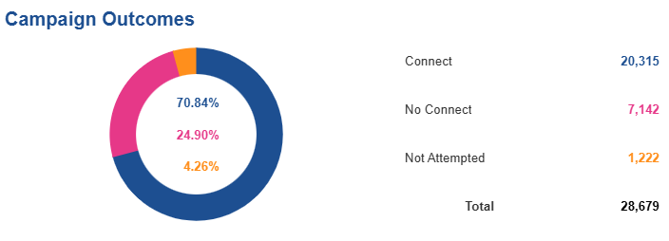
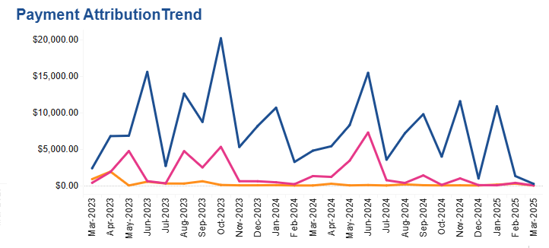
Dialer: Return Mail Results --- Optional
Return Mail Dialer: <<Insert Period>>
Total accounts in campaign: <<Insert>>
  Average monthly: <<Insert Volume>>>
Value:
Assume it takes 5 minutes to manually dial and leave message / talk to patient:
  <<insert>>hours or <<insert>> FTE’s
  <<insert>> FTE Cost savings
Campaign Attributed Payments: $<<insert>>

Slide 20
Return Mail Scrub: Trends
Insert Observations and/or proposals
***Consider reviewing the : “Times Ran” figure from the Return Mail Dashboard. Could indicate they are not removing Return Mail Status or working accounts if pushed to a WQ.

Slide 21
Medicaid Scrub
Unlimited Transactions
Conversion of Self Pay to Medicaid
Vendor Cost Avoidance
Statement Cost Avoidance
  How the Medicaid Scrub workflow is used by <<insert>>
  Insert summary

Slide 22
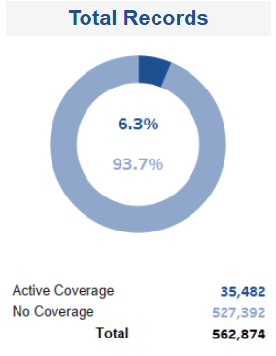
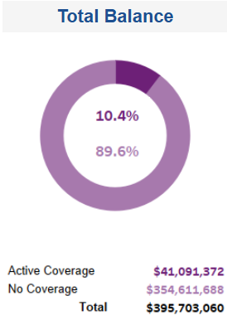
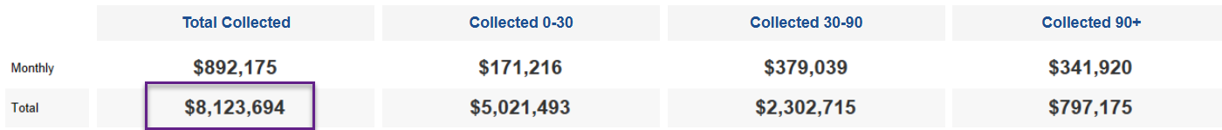
Screening: Medicaid Scrub Results
Medicaid Scrub: <<Insert Period>>
Total records scrubbed: <<Insert Volume @ $Insert Dollars>>
  Average monthly: <<Insert Volume @ $Insert Dollars>>
Total Active Medicaid Finds: <<Insert Volume @ $Insert Dollars>>
  Find Rate: <<insert %>> of volume / <<Insert %>> of dollars
Value:
Medicaid Payments: $<<Insert>>
  Average Monthly: $<<Insert>>
Assume it takes 1 minute to drop claim to Medicaid:
  <<insert>>hours or <<insert>> FTE’s
  <<insert>> FTE Cost savings

Slide 23
Medicaid Scrub: Trends
Insert Observations and/or proposals
***Consider reviewing the : average conversion days and conversion rate. Provides insight to how quickly they are working Medicaid results.

Slide 24
Presumptive Charity
Federal Poverty Level Insights
(Unlimited)
Compliance with Charity Policies
100% Automation Reducing Manual Work
Bad Debt Prevention
  How the Presumptive Charity workflow is used by <<Insert>>:
  Insert summary

Slide 25

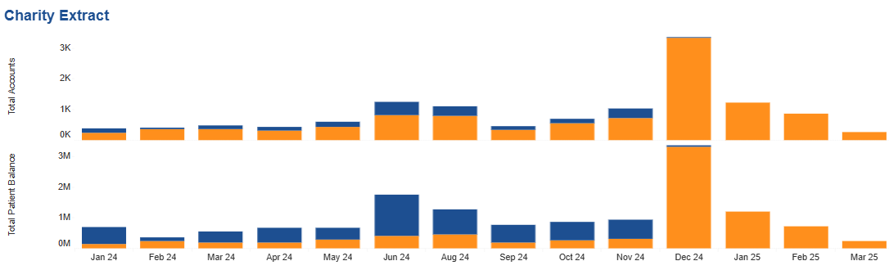
Screening: Charity Scrub: Result
Value:
Assume it takes 10 minute to manually work a charity application:
  <<insert>>hours or <<insert>> FTE’s
  <<insert>> FTE Cost savings
Statement Cost Avoidance: $<<insert>>
Charity Scrub: <<Insert Period>>
Charity Results: <<Insert Volume @ $Insert Dollars>>
  Average monthly: <<Insert Volume @ $Insert Dollars>>
Notes:
71,108 @ $75,910,900 = 100% adjustment

Slide 26
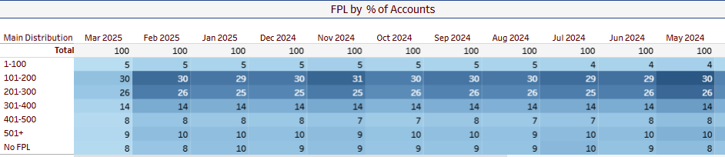
Charity Scrub: YoY Trend
Insert Observations and/or proposals
***Consider reviewing :
Charity Adjustment vs. Charity Results.
Charity results are what we sent. Charity adjustment shows what was converted to charity.
Charity Conversion: Day to convert, % to convert, times ran = indicators of processing charity results.
Consider reviewing FPL Distribution to understand changes in FPL

Slide 27
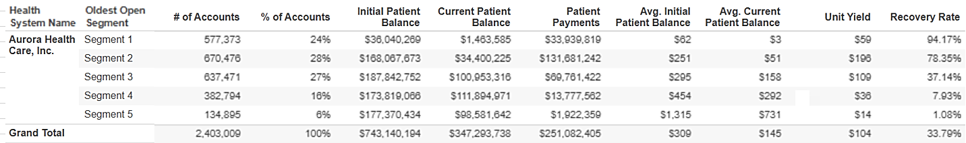
Segmentation Performance – Aged to 6 Months:
Segmentation: Data Driven Collection Strategy
Segment 1 & 2:
52% of volume / 66% of payments
Segment 1, 2 & 3:
78% of volume / 94% of payments

Slide 28
Segmentation – Aged to 6 Months: YoY Trend
 | % of Volume |  |  |  |  | % of Payments |  |  |  |  | Ave Recovery |  |  |  |  | Ave Yield
 |  | 2020 | 2021 | 2022 | 2023 |  | 2020 | 2021 | 2022 | 2023 |  | 2020 | 2021 | 2022 | 2023 |  | 2020 | 2021 | 2022 | 2023
Segment 1 |  | 19% | 20% | 23% | 24% |  | 8% | 9% | 12% | 14% |  | 93.3% | 96.1% | 91.0% | 94.2% |  | $51 | $55 | $52 | $59
Segment 2 |  | 24% | 27% | 28% | 28% |  | 46% | 50% | 53% | 52% |  | 87.1% | 87.8% | 77.6% | 78.4% |  | $213 | $219 | $192 | $196
Segment 3 |  | 26% | 26% | 25% | 27% |  | 32% | 31% | 28% | 28% |  | 50.4% | 49.1% | 38.4% | 37.1% |  | $138 | $138 | $111 | $109
Segment 4 |  | 17% | 22% | 16% | 16% |  | 8% | 9% | 6% | 5% |  | 16.9% | 15.5% | 9.5% | 7.9% |  | $49 | $47 | $40 | $36
Segment 5 |  | 14% | 6% | 6% | 5% |  | 5% | 1% | 1% | 1% |  | 6.4% | 2.1% | 1.4% | 1.1% |  | $41 | $22 | $17 | $14
Observations:
Segment 1: Model increase in volume (+1%). Experienced greater success in collections (14% of payments / 94% recovery)
Segment 2: Model volume flat - Increased Recovery Rate
Segment 3: Model volume increased (2%) – harder to collect population. Recovery rate reflects slight drop (unit yield decreased).

Slide 29
Segmentation: Benchmark Performance

Slide 30
Segmentation: Patient Payment Impact
Patient Payments
(Aug 22 – Jul 23)
$394,508,991
Patient Payments
(Aug 23 – Jul 24)
$394,602,506
Patient Payment Change
+$93,515
Insert observations
Recovery Rate
(Aug 22 – Jul 23)
7.59%
Recovery Rate
(Aug 23 – Jul 24)
7.12%
Recovery Rate Change
-0.47%
Base Line Recovery Analysis
Period | Patient Balance | Patient Payment | Recovery Rate
Aug 23 – Jul 24 | $5,276,613,542 | $394,602,506 | 7.48%
Base line recovery rate: 5.4% If continued to collect at the pre-segmentation recovery rate of 5.4%: Patient Payments would have been: $284,937,131 This period patient payment loss of: -$109,665,375
Notes:
AR Tends:
New accounts entering AR flat (+0.8%)
Patient balances for new AR increased (+17%)
As a result, the recovery rate drop as compared to last period (8.13% vs. 7.48%)

Slide 31

Bad Debt Performance

Slide 32
Agency Performance & Reconciliation
Increase Bad Debt Collections
Data Insights to drive Placement Strategy
Compliance through Reconciliation
  How the Agency Performance & Reconciliation is used by <<Insert>>:
  Insert summary

Slide 33

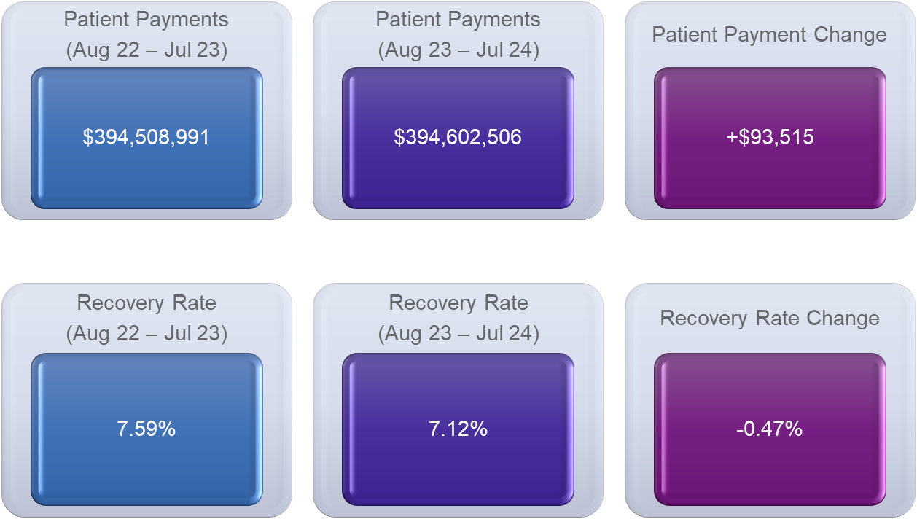
Agency Performance: Performance
Notes:
AR Tends:
New accounts entering AR flat (+0.8%)
Patient balances for new AR increased (+17%)
As a result, the recovery rate drop as compared to last period (8.13% vs. 7.48%)

Slide 34
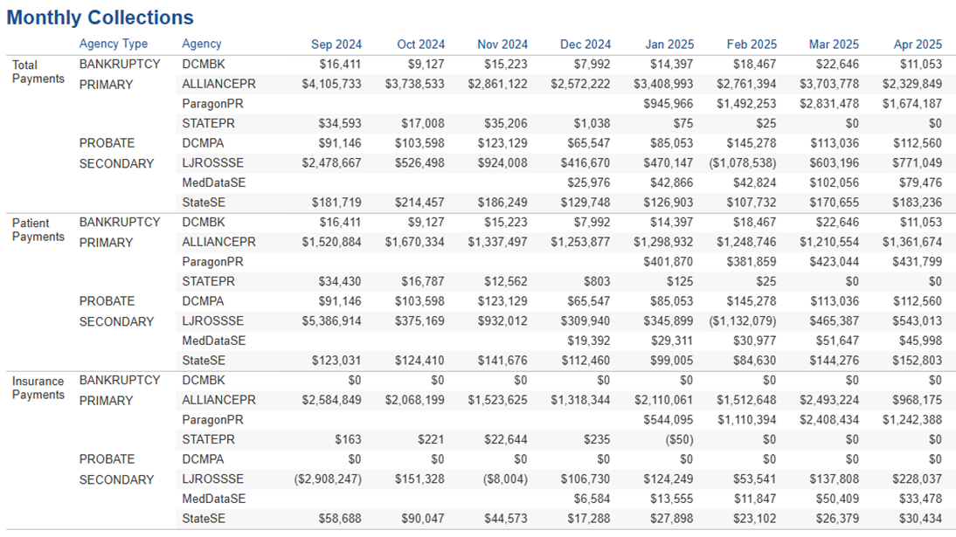
Agency Performance: Collection Comparison
Notes:
AR Tends:
New accounts entering AR flat (+0.8%)
Patient balances for new AR increased (+17%)
As a result, the recovery rate drop as compared to last period (8.13% vs. 7.48%)

Slide 35
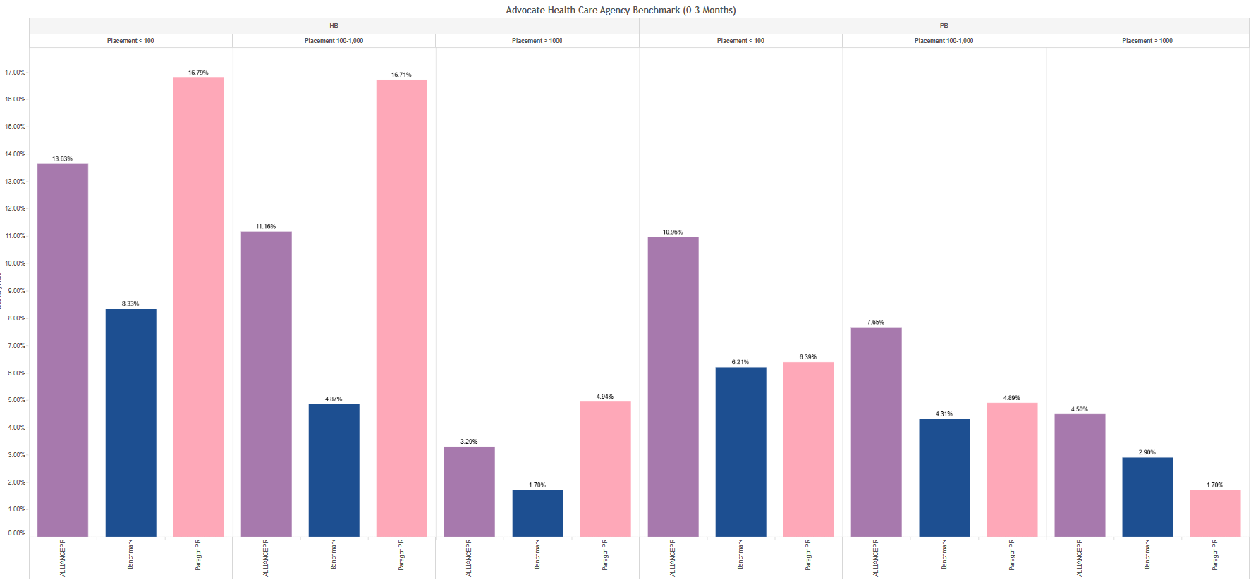
Agency Performance: Benchmarking
Notes:
AR Tends:
New accounts entering AR flat (+0.8%)
Patient balances for new AR increased (+17%)
As a result, the recovery rate drop as compared to last period (8.13% vs. 7.48%)

Slide 36
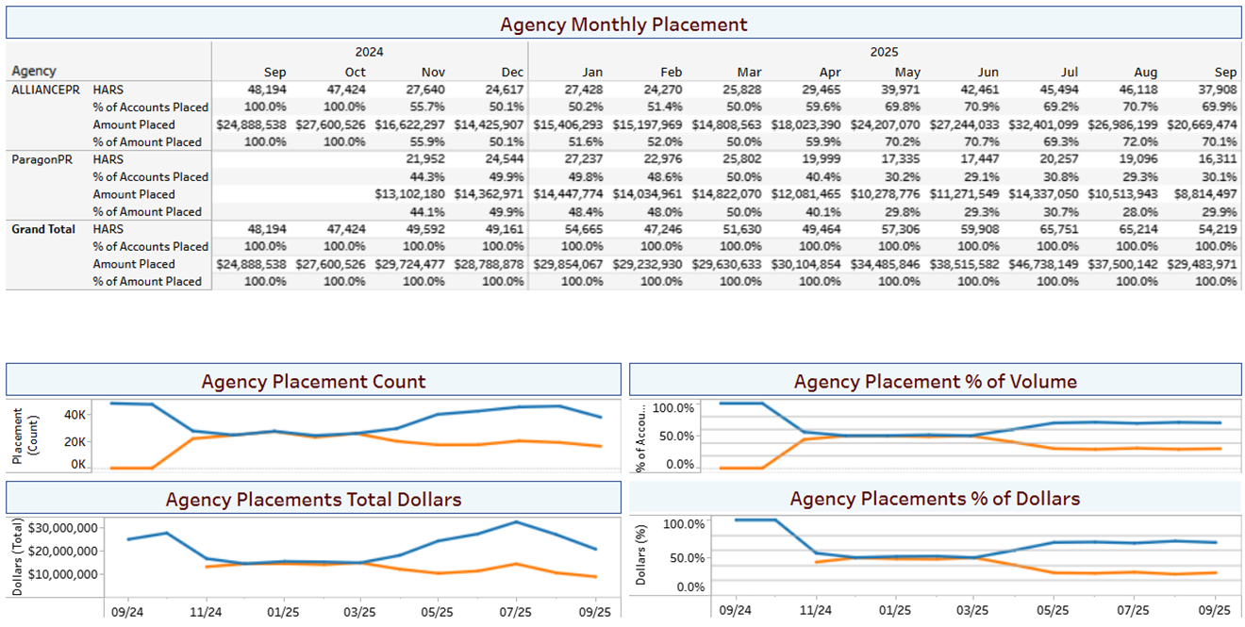
Agency Performance: Placement Trends
Notes:
AR Tends:
New accounts entering AR flat (+0.8%)
Patient balances for new AR increased (+17%)
As a result, the recovery rate drop as compared to last period (8.13% vs. 7.48%)

Slide 37
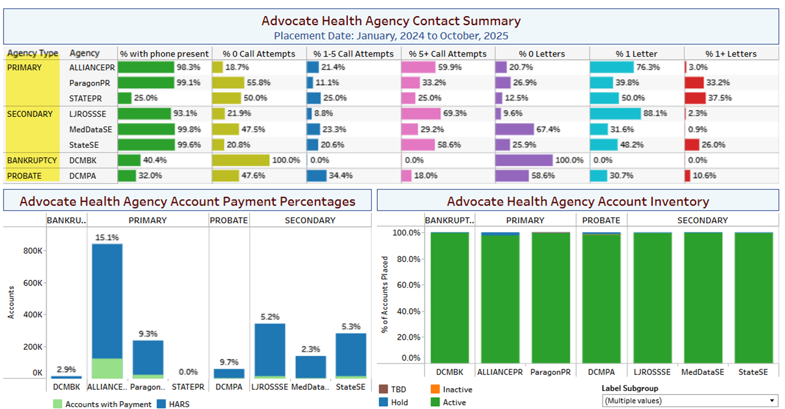
Agency Performance: Contact Effort Trends
Notes:
AR Tends:
New accounts entering AR flat (+0.8%)
Patient balances for new AR increased (+17%)
As a result, the recovery rate drop as compared to last period (8.13% vs. 7.48%)

Slide 38
Agency Performance: Agency Reconciliation
Wins (8/23 – 10/24) | Report | SA10 | SA9000
Identifying accounts where the original agency has not closed the account after placement to next agency. Compliance Avoidance | Same Account Multiple Agencies | 4,910 @ $1,926,079 | 2,308 @ $1,141,020
Agency closing account when should be open Patient Satisfaction | Closed Drill Down | 552 @ $5,376,547 | 2,495 @ $5,453,423
Agency keeping accounts open when should be closed. Compliance Avoidance | Provider Closed Agency Open | 13,095 @ $6,200,161
Placement file not loaded Potential Missed Collections | Dynamic Recon | 6,126 @ $2,238,481 | 4,019 @ $1,831,109
Total |  | 24,683 @ $15,741,268 | 8,822 @ $8,425,552
Notes:
Provider Closed Agency Open:
LJ Ross not processing transaction files / issues with posting transactions after their system migration. Mostly terminal bad debt adjustments.

Slide 39
Utilization Benefit Summary
(ROI)

Slide 40
Collection Optimization: Value Delivery
Process | Value Summary | Value
Address Verification Correction of addresses at time of service or pre-financial clearance. | Return Mail Statement Cost Avoidance | $xxxxx Statement Cost Avoidance
Address Verification Correction of addresses at time of service or pre-financial clearance. | Return Mail Manual Work Cost Avoidance | xxxxx FTE Hours or XXX FTE’s Saved for Automation $xxxxx FTE Hour Cost Savings
Bankruptcy Scrub Perpetual monitoring of all patient balances for bankruptcy activity. | Manual Work Cost Avoidance | xxxxx FTE Hours or xxx FTE’s Saved for Automation $xxxxx FTE Hour Cost Savings
Bankruptcy Scrub Perpetual monitoring of all patient balances for bankruptcy activity. | Bankruptcy Revenue Stream | $xxxxxx in Agency Recovery (Insert Total Payments – above number is minus contingency fee of xxx%)
Deceased Scrub Recurring scrubs of all patient balances for deceased activity. | Manual Work Cost Avoidance | xxxxx FTE Hours or xxx FTE’s Saved for Automation $xxxxx FTE Hour Cost Savings
Deceased Scrub Recurring scrubs of all patient balances for deceased activity. | Deceased Revenue Stream | $xxxxxx in Agency Recovery (Insert Total Payments – above number is minus contingency fee of xxx%)
Notes:
FTE: $35k a year or $16.82 an hour
Period is 15 months: FTE Hours would be 2600 (not 2080)

Slide 41
Collection Optimization: Value Delivery
Process | Value Summary | Value
Deceased Scrub Recurring scrubs of all patient balances for deceased activity. | Deceased Collections | $xxxxx Deceased Collections
Return Mail Continuous scrubbing of known bad addresses. Corrected addresses provided back to improve collection feasibility. | Manual Work Cost Avoidance | xxxxx FTE Hours or XXX FTE’s Saved for Automation $xxxxx FTE Hour Cost Savings
Return Mail Dialer Automated call campaign on Return Mail accounts. | Return Mail Dialer – Manual Work Cost Avoidance | xxxxx FTE Hours or xxx FTE’s Saved for Automation $xxxxx FTE Hour Cost Savings
Medicaid Scrub Recurring scrub on all self pay / Medicare No Secondary accounts. . | Medicaid Payments | $xxxxx Medicaid Payments
Medicaid Scrub Recurring scrub on all self pay / Medicare No Secondary accounts. . | Manual Work Cost Avoidance | xxxxx FTE Hours or xxx FTE’s Saved for Automation $xxxxx FTE Hour Cost Savings
Medicaid Scrub Recurring scrub on all self pay / Medicare No Secondary accounts. | Vendor Fee Cost Avoidance | $xxxxxx Vendor Cost Avoidance
Notes:
FTE: $35k a year or $16.82 an hour
Period is 15 months: FTE Hours would be 2600 (not 2080)

Slide 42
Collection Optimization: Value Delivery
Process | Value Summary | ROI Benefit
Medicaid Scrub Recurring scrub on all self pay / Medicare No Secondary accounts. | Statement Cost Avoidance | <<$ Statement Cost Avoidance>>
Presumptive Charity Scrub Recurring scrub on all self pay using FPL and/or Segment to auto qualify accounts for write off | Statement Cost Avoidance | <<$ Statement Cost Avoidance>>
Segmentation Driven Collection Strategy using segmentation to drive increased collections | Patient Collections | <<Insert lift>>> **If negative lift, leave out.
Total Benefits | <<insert sum of dollar value>> <<insert>> FTE Hour Savings via Automation (insert # FTE)
Return on Investment | 10 : 1 ROI
Notes:
FTE: $35k a year or $16.82 an hour
Period is 15 months: FTE Hours would be 2600 (not 2080)

Slide 43
Collection Optimization: Additional Benefits
***Value not included in value delivery number presented on previous slide
Process | Benefit | Benefit Value
Address Verification | Unlimited transactions Correction of addresses at point of service, making statements deliverable. | <Insert Volume> Insert % New, % Improved, Total New & Improved %
Address Verification | Improved addresses increases ability to collect due to deliverable statements. | Impacted AR for Improved: <Insert $>
Patient Financial Clearance | Unlimited transactions.. Provides financial insights on all patients at or before service. Financial Insights includes Propensity to Pay and FPL (income/household size estimates). | <Insert volume>
Bankruptcy Scrubs | Unlimited transactions. Monitoring all Active AR and Bad Debt accounts for bankruptcy notifications. | <Insert volume monitored> <Insert % Chapter 7 and % Chapter 13>
Deceased Scrubs | Unlimited transactions. Monitoring all Active AR and Bad Debt for deceased notifications. | <Insert volume scrubbed> <Insert deceased hit volume>
Return Mail Scrubs | Unlimited Transactions. Tracks patient payments after address was corrected. | <<$xxxx>> - insert collections (Dashboard) <<$xxxx>> - insert Dialer Call Attribution
Medicaid Scrubs | Unlimited, recurring Medicaid scrub. Conversion of self pay accounts to Medicaid for reimbursement. | <Insert Volume Scrubbed / Balance Scrubbed> <Insert active volume / balance> <Insert Find %>
Notes:
FTE: $35k a year or $16.82 an hour
Period is 15 months: FTE Hours would be 2600 (not 2080)

Slide 44
Collection Optimization: Additional Benefits
***Value not included in value delivery number presented on previous slide
Process | Benefit | Benefit Value
Charity Scrub | Unlimited transactions providing financial insights for all patients. Allows for charity automation to comply with policy & regulations. | <<Insert volume & charity amount>>
Compliance Manager | Continuous monitoring of collection agency’s state licensing status (all 50 states). | Compliance
Agency Reconciliation Reporting | Dynamic / Not Claimed Same Account Claimed by Multiple Agencies Not Matching – Different Agencies Closed Drill Down Provider Closed-Agency Open Balance Difference | <<Insert volume & dollars>>
AR Performance Reporting | AR Performance Summary Performance Dashboard Inventory by Year Payer Scorecards Open AR Aging Segmentation FPL Breakout Charity Tracking Payment Plans Guarantor State AR Batch Dashboard | AR Performance
Collection Triggers | Daily updates to all collection agencies providing insight to patient financial behavior changes, indicating new ability to pay (i.e. new job, new line of credit, paying down debt). | Aides Agency Collection Strategy
Notes:
FTE: $35k a year or $16.82 an hour
Period is 15 months: FTE Hours would be 2600 (not 2080)

Slide 45
Collection Optimization: Additional Benefits
***Value not included in value delivery number presented on previous slide
Process | Benefit | Benefit Value
Agency Performance Reporting | Agency Offload Dashboard Agency Dashboard Agency Days to Closed Summary Inventory, Performance & Contact Agency Inventory Agency SIF Inventory Agency Status by Placement Age Batch Performance Summary Batch Performance Net Back Batch Contact Letter Audit Agency Segmentation | Insights to self pay vendor performance, status of inventory & due diligence efforts.
Notes:
FTE: $35k a year or $16.82 an hour
Period is 15 months: FTE Hours would be 2600 (not 2080)

Slide 46
SUCCESS PLAN
Summary/Recommendations
Experian Solutions to improve RCM Success
Recommended Strategies for Existing Product Adoption
Strategic Engagement
Analytics
Power Reporting
Projects
Next Steps
Subtitle:
Bullet
Bullet
Bullet
Bullet
Subtitle:
Bullet
Bullet
Bullet
Bullet
Subtitle:
Bullet
Bullet
Bullet
Bullet
Subtitle:
Bullet
Bullet
Bullet
Bullet
Subtitle:
Bullet
Bullet
Bullet
Bullet
Subtitle:
Bullet
Bullet
Bullet
Bullet
Notes:
RM Notes:
Use this slide to summarize your review: Some Suggestions
Experian Products to Enhance Success
Chance for you and sales team to talk about new products
Current Product Recommendations
Health Checks
Standardization reviews
Workflow recommendations
Strategic engagement
List out your call cadence or ke meetings that have taken place or scheduled
Analytics and Power Reporting
How many users they have in the portal
Are they using
Training needed
Projects
Any implementations in flight
Any Standardizations in flight
Any Health checks in flight
Next Steps
-

Slide 47




Scorecard: Screening and Segmentation
Feature
Optimal Utilization
Implemented
Your Utilization
AR file extract imported to HIS; delivery to work queue, automation that has streamlined process and creates efficiency in revenue cycle process
Bankruptcy
Best in Class
AR file extract imported to HIS; delivery to work queue, automation that has streamlined process and creates efficiency in revenue cycle process
Deceased
Better (Routes to WQ – pending Automation)
HIS imports results, build of custom rules, use of Experian forms, automation that has streamlined process and creates efficiency in revenue cycle process
Better – Pending further discussion with Operational Leader
Medicaid
AR file extract imported to HIS; delivery to work queue, automation that has streamlined process and creates efficiency in revenue cycle process
Return Mail
Best in Class
Presumptive Charity
AR file extract imported to HIS; delivery to work queue, automation that has streamlined process and creates efficiency in revenue cycle process
Best in Class
AR file sent through automation with automated import of results; segment data utilized in focused collection efforts; benchmarking reviewed; improvements documented
Segmentation
Better
Possible ratings: Good, Better, Best in Class

Slide 48

Management
Feature
Optimal Utilization
Implemented
Your Utilization
Analysis of AR file and results are driven to multiple outputs based on conditional rules leading to different execution strategies. Can be completely automated.
Routing
Good
AR Management
Evaluation of collection performance with reporting review, benchmark against industry standards to drive strategy discussions, and engage in champion/challenger analysis for improvements
Better – based on commitment to review monthly
Agency and Bad Debt Management
Benchmark performance, engage in reconciliation for accuracy, use champion/challenger, and utilize Compliance Manager to monitor agency compliance and reputation
Better – based on commitment to review monthly
Receive trigger files, deliver trigger files to agencies, and take actions (contacts attempted) after delivery to work queues
Monitor
Best in Class
Monthly meeting; consistent report review with open channels of communication for operational improvement; semi-annual onsite ROI and operational review
Consulting
Better
Dialer Campaigns
Campaigns based on segmentation and additional attributes with results delivered to HIS; automated contact strategies; utilize IVR for automation
Better
Possible ratings: Good, Better, Best in Class

Slide 49

Closer Look
What does Best-in-Class look like for <<Insert>>?
Insert proposed action
Insert proposed action
Insert proposed action
Notable accomplishments:
Insert

Slide 50


Utilization Summary
Collections Optimization (CO) Manager: data-driven self-pay receivables management system that optimizes collection strategy from account creation to zero balance. The scorecard is an overview of how University of Utah Health is performing compared to CO utilization benchmarks.
<<Insert client name>> is outperforming <<Insert area>>
<<Insert where shine – example below>>
Screening
Utilization of multiple screening processes with automation and digestion into University of Utah HIS that has created efficiencies. Keep it up!
<<Insert where to improved – example below>>
Segmentation – Strategy
Add 1 call to Segment 1 (Day 150)
Add 2 calls to Segment 2 (Day 140 and 160)
Add 3 calls to Segment 3 (Days 135, 150, 165)
Where you
Shine!
Where to
Improve

